Slide 1
18ECE220T- Unit 2- Multicarrier Modulation Technique – OFDM
Introduction to OFDM Multicarrier Modulation Introduction
Multicarrier Modulation Cyclic Prefix, Channel model &
SNR calculation

Slide 2
Introduction to OFDM
Wireline and wireless, fixed and mobile communications or networking technologies have chosen OFDM to achieve higher data rate (what is called broadband).
Examples of such technologies are: ADSL, HomePlug AV, WiMedia UWB, Wi-Fi (802.11a/g), WiMAX.

Slide 3
Multiplexing
Capacity of transmission medium usually exceeds capacity required for transmission of a single signal
Multiplexing - carrying multiple signals on a single medium
More efficient use of transmission medium

Slide 4
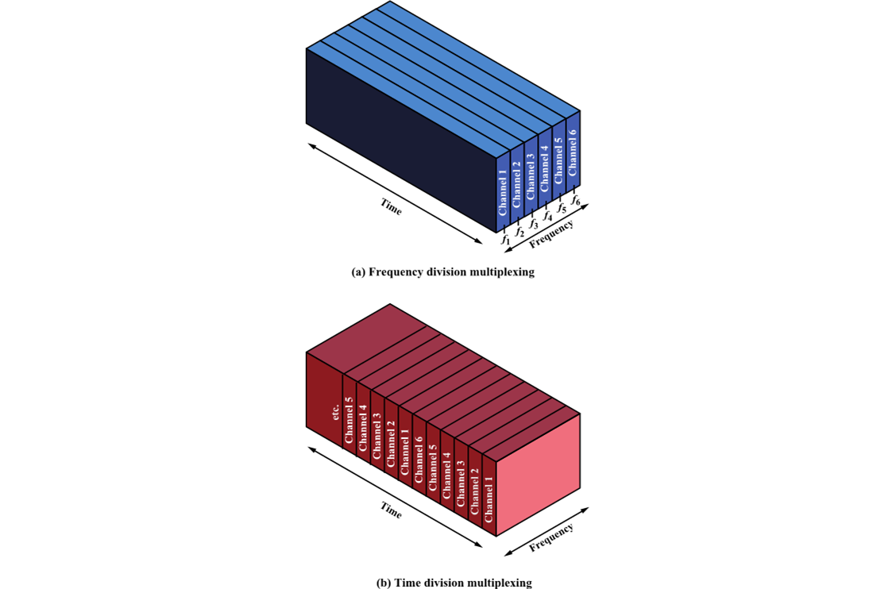
Multiplexing Techniques
Frequency-division multiplexing (FDM)
Takes advantage of the fact that the useful bandwidth of the medium exceeds the required bandwidth of a given signal
Time-division multiplexing (TDM)
Takes advantage of the fact that the achievable bit rate of the medium exceeds the required data rate of a digital signal

Slide 5
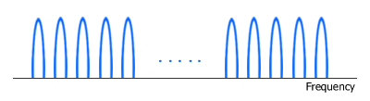
Introduction to OFDM (Contd)
WiMAX air interface is based on OFDM/OFDMA physical layer (PHY).
To understand how OFDM and OFDMA work, it is useful to start with its "mother" namely FDM (Frequency Division Multiplexing).
In FDM system, signals from multiple transmitters are transmitted simultaneously (at the same time slot) over multiple frequencies.
Each frequency range (sub-carrier) is modulated separately by different data stream and a spacing (guard band) is placed between sub-carriers to avoid signal overlap.

Slide 6
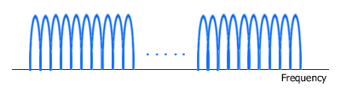
Orthogonal Frequency Division Multiplexing (OFDM)
Like FDM, OFDM also uses multiple sub-carriers but the sub-carriers are closely spaced to each other without causing interference, removing guard bands between adjacent sub-carriers.
This is possible because the frequencies (sub-carriers) are orthogonal, meaning the peak of one sub-carrier coincides with the null of an adjacent sub-carrier.

Slide 7
OFDM
OFDM is a spectrally efficient version of multicarrier modulation, where the subcarriers are selected such that they are all orthogonal to one another over the symbol duration, thereby avoiding the need to have non-overlapping subcarrier channels to eliminate inter-carrier interference.
In order to completely eliminate ISI, guard intervals are used between OFDM symbols.
By making the guard interval larger than the expected multipath delay spread, ISI can be completely eliminated. Adding a guard interval, however, implies power wastage and a decrease in bandwidth efficiency.

Slide 8
OFDM
OFDM belongs to a family of transmission schemes called multicarrier modulation, which is based on the idea of dividing a given high-bit-rate data stream into several parallel lower-bit-rate streams and modulating each stream on separate carriers, often called subcarriers or tones.
Multicarrier modulation schemes eliminate or minimize inter-symbol interference (ISI) by making the symbol time large enough so that the channel-induced delays are an insignificant (typically, < 10 percent) fraction of the symbol duration.
Therefore, in high-data-rate systems in which the symbol duration is small, being inversely proportional to the data rate splitting the data stream into many parallel streams increases the symbol duration of each stream such that the delay spread is only a small fraction of the symbol duration.

Slide 9
Features of OFDM
In an OFDM system, a very high-rate data stream is divided into multiple parallel low-rate data streams.
Each smaller data stream is then mapped to an individual data sub-carrier and modulated using some sort of PSK (Phase Shift Keying) or QAM (Quadrature Amplitude Modulation). i.e. BPSK, QPSK, 16-QAM, 64-QAM.
OFDM needs less bandwidth than FDM to carry the same amount of information which translates to higher spectral efficiency.
Besides a high spectral efficiency, an OFDM system such as WiMAX is more resilient in NLOS environment. It can efficiently overcome interference and frequency-selective fading caused by multipath because equalizing is done on a subset of sub-carriers instead of a single broader carrier.
The effect of ISI (Inter Symbol Interference) is suppressed by virtue of a longer symbol period of the parallel OFDM sub-carriers than a single carrier system and the use of a cyclic prefix (CP).

Slide 10
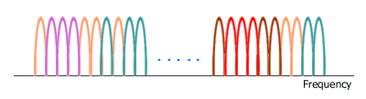
Orthogonal Frequency Division Multiple Access (OFDMA)
Like OFDM, OFDMA employs multiple closely spaced sub-carriers, but the sub-carriers are divided into groups of sub-carriers.
Each group is named a sub-channel. The sub-carriers that form a sub-channel need not be adjacent. In the downlink, a sub-channel may be intended for different receivers. In the uplink, a transmitter may be assigned one or more sub-channels.

Slide 11
OFDMA
Orthogonal Frequency Division Multiple Access (OFDMA) uses OFDM to share the wireless channel
Different users can have different slices of time and different groups of subcarriers
Subcarriers are allocated in groups
Called subchannels or resource blocks
Too much computation to allocate every subcarrier separately
Subchannel allocation
Adjacent subcarriers – similar SINR
Must measure to find the best subchannel
Regularly spaced subcarriers – diverse SINR
Randomly space subcarriers – diverse SINR and reduced adjacent-cell interference

Slide 12
OFDMA
Subchannelization defines sub-channels that can be allocated to subscriber stations (SSs) depending on their channel conditions and data requirements.
Using subchannelization, within the same time slot a Mobile WiMAX Base Station (BS) can allocate more transmit power to user devices (SSs) with lower SNR (Signal-to-Noise Ratio), and less power to user devices with higher SNR.
Subchannelization also enables the BS to allocate higher power to sub-channels assigned to indoor SSs resulting in better in-building coverage.

Slide 13
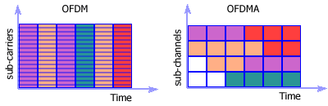
OFDMA
In OFDMA, several SS's can transmit at the same time slot over several sub-channels.
Subchannelization in the uplink can save a user device transmit power because it can concentrate power only on certain sub-channel(s) allocated to it.
This power-saving feature is particularly useful for battery-powered user devices, the likely case in Mobile WiMAX.

Slide 14
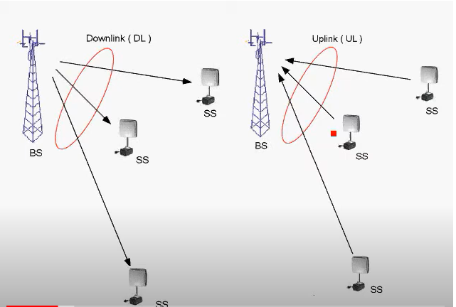
OFDMA

Slide 15
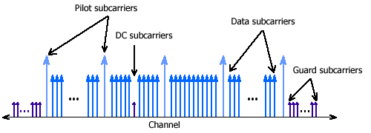
OFDM and OFDMA Symbol Structure
Both OFDM and OFDMA symbols are structured in similar way. Each symbol consists of:
- data sub-carriers (OFDM) or sub-channels (OFDMA) that carry data (information),
- pilot sub-carriers as reference frequencies and for various estimation purposes,
- DC sub-carrier as the center frequency, and
- guard sub-carriers or guard bands for keeping the space between OFDM/OFDMA signals.

Slide 16
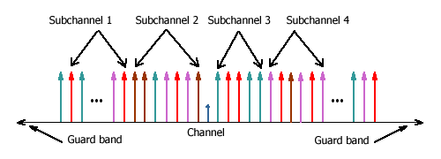
OFDMA symbol structure in WiMAX
Sub-carriers of the same color represent a sub-channel.

Slide 17
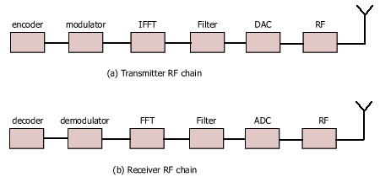
Basic building blocks of a Tx RF chain and a Rx RF chain.

Slide 18
Scalable OFDMA (SOFDMA)
SOFDMA (S-OFDMA) adds scalability to OFDMA.
It scales the FFT size to the channel bandwidth while keeping the sub-carrier frequency spacing constant across different channel bandwidths.
Smaller FFT size is given to lower bandwidth channels, while larger FFT size to wider channels.
By making the sub-carrier frequency spacing constant, SOFDMA reduces the system complexity of smaller channels and improves the performance of wider channels.
As a reminder, IFFT (Inverse Fast Fourier Transform) is used in a WiMAX transmitter to create an OFDM waveform from modulated data streams, while FFT (Fast Fourier Transform) is used in a WiMAX receiver to demodulate the data streams.
The FFT size equals the number of sub-carriers, e.g. in an OFDM/OFDMA system with 256 sub-carriers, the FFT size is 256.

Slide 19
SOFDMA
SOFDMA is the OFDMA mode used in Mobile WiMAX. It supports channel bandwidths ranging from 1.25 MHz to 20 MHz.
With bandwidth scalability, Mobile WiMAX technology can comply with various frequency regulations worldwide and flexibly address diverse operator or ISP requirements, that's whether for providing only basic Internet service or a broadband service bundle.

Slide 20
OFDM TX
Start with a data stream of R bps
Could be sent with bandwidth Nf_{b}
With bit duration 1/R
OFDM splits into N parallel data streams
Called subcarriers
Each with bandwidth f_{b}
And data rate R/N (bit time N/R

Slide 21
Orthogonality
The spacing of the f_{b} frequencies allows tight packing of signals
Actually with overlap between the signals
Signals at spacing of f_{b} ,2f_{b}, 3f_{b} ,etc.
The choice of f_{b} is related to the bit rate to make the signals orthogonal
Average over bit time of s₁(t) × s₂(t) = 0
Receiver is able to extract only the s₁(t) signal
If there is no corruption in the frequency spacing
NOTE – Traditional FDM makes signals completely avoid frequency overlap
OFDM allows overlap which greatly increases capacity

Slide 22
Orthogonality Concepts
Given an OFDM subcarrier bit time of T
f_{b} must be a multiple of 1/T
Recall f_{b} is the frequency of one OFDM subcarrier
Example: IEEE 802.11n WLAN
20 MHz total bandwidth
Only 15 MHz can be used
48 subcarriers
f_{b} = 0.3125 MHz (= N/B = 15/48 in this example)
Signal is translated to 2.4 GHz or 5 GHz bands

Slide 23
Benefits of OFDM
Frequency selective fading only affects some subcarriers
Can easily be handled with a forward error-correcting code
More importantly, OFDM overcomes intersymbol interference (ISI)
ISI is a caused by multipath signals arriving in later bits
OFDM bit times are much, much longer (by a factor of N)
ISI is dramatically reduced
Design aside: N is chosen so the root-mean-square delay spread is significantly smaller than the OFDM bit time
It may not be necessary to deploy equalizers to overcome ISI
Eliminates the use of these complex and expensive devices!!!

Slide 24
OFDM Implementation
Inverse Fast Fourier Transform (IFFT)
The OFDM concept would use N oscillators for N different subcarrier frequencies
Expensive for transmitter and receiver
Discrete Fourier Transform (DFT) processes digital signals
If N is a power of two, the computational speed dramatically improves by using the fast version of the DFT (FFT)
Transmitter takes a symbol from each subcarrier
Makes an OFDM symbol
Uses the Inverse FFT to compute the data stream to be transmitted
OFDM symbol provides the weights for each subcarrier
Then it is sent on the carrier using only one oscillator

Slide 25
IFFT OFDM Implementation

Slide 26
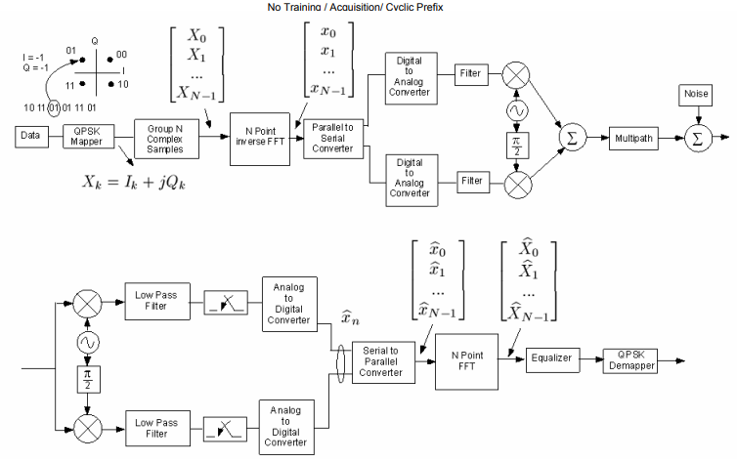
OFDM System Model

Slide 27
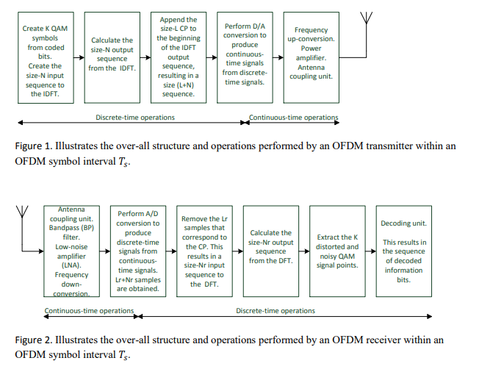
OFDM System Model

Slide 28
Cyclic Prefix
OFDM’s long bit times eliminate most of the ISI
OFDM also uses a cyclic prefix (CP) to overcome the residual ISI
Adds additional time to the OFDM symbol before the real data is sent
Called the guard interval
ISI diminishes before the data starts
Design Aside: Data from the end of the OFDM symbol is used as the CP
Simplifies the computations

Slide 29
OFDM Symbol Format

Slide 30
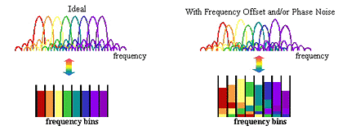
Issues of OFDM
OFDM is also sensitive to carrier frequency variations.
Frequency offset can occur when the voltage-controlled oscillator (VCO) at the receiver is not oscillating at exactly the same carrier frequency as the VCO in the transmitter.
To overcome this problem, OFDM systems transmit pilot carriers along with the subcarriers for synchronization at the receiver.
Another disadvantage is that an OFDM signal has a high peak to average power ratio
Peak-to-average power ratio (PAPR)
For OFDM signals, this ratio is much higher than for single-carrier signals
OFDM signal is a sum of many subcarrier signals
Total can be very high or very low

Slide 31
Solutions
Could reduce the peak amplitude
Called input backoff
But this would increase the signal to interference plus noise ratio (SINR)
Noise and interference would be relatively stronger because signal is weaker
Specific PAPR reduction techniques can be used
Specialized coding, phase adjustments, clipping, etc.
Single-carrier FDMA (SC-FDMA)

Slide 32
Intercarrier Interference
Intercarrier Interference (ICI)
OFDM frequencies are spaced very precisely
Channel impairments can corrupt this
Cyclic prefix helps reduce ICI
But CP time should be limited so as to improve spectral efficiency
A certain level of ICI may be tolerated to have smaller CPs
Doppler spread, mismatched oscillators, or even one subcarrier can cause ICI
Spacing between subcarriers may need to be increased
Could also use different pulse shapes, self-interference cancellation, or frequency domain equalizers

Slide 33
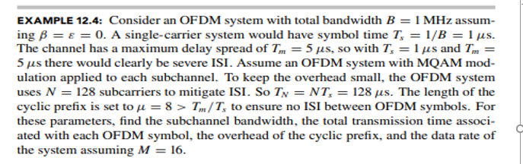
OFDM Problem-1

Slide 34
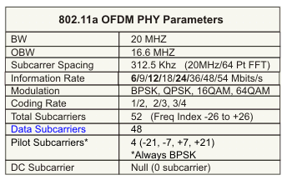
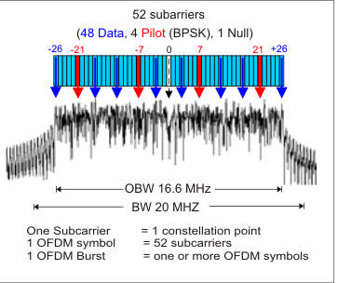
IEEE 802.11a OFDM Physical Parameters
References:
[1] IEEE 802.11a-1999: High-Speed Physical Layer in the 5 GHz Band, 1999.
[2] IEEE 802.11g-2003: Further Higher-Speed Physical Layer Extension in the 2.4 GHz Band, 2003.

Slide 35
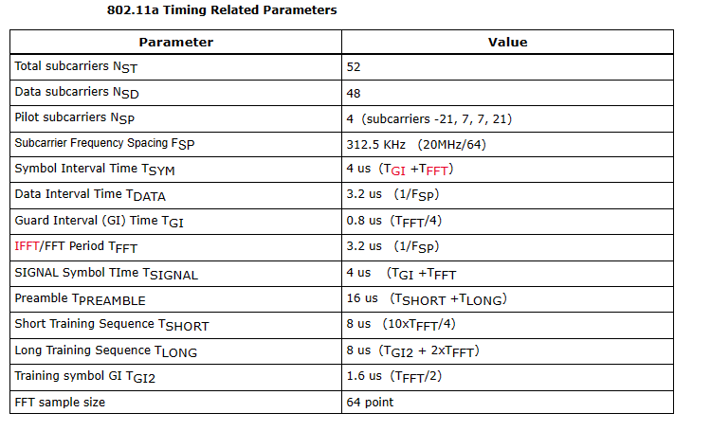
IEEE 802.11a OFDM Physical Parameters

Slide 36
Wireless Communication Channels
Communications over wireless channels suffer from multi-path propagation
Multi-path channels are usually frequency selective
OFDM supports high data rate communications over frequency selective channels

Slide 37
Multi-Path Propagation Modeling
Power
Multi-Path Components
τ₀
τ₁
τ₂
Time
Multi-path results from reflection, diffraction, and scattering off environment surroundings
Note: The figure above demonstrates the roles of reflection and scattering only on multi-path

Slide 38
Multi-Path Propagation Modeling
Power
Multi-Path Components
τ₀
τ₁
τ₂
Time
As the mobile receiver (i.e. car) moves in the environment, the strength of each multi-path component varies

Slide 39
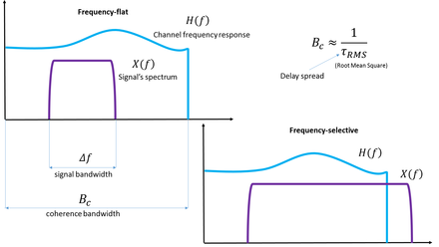
Multipath Fading
Multipath Fading: It occurs when a signal reaches the receiver from various paths i.e. when multipath propagation takes place.
Multipath fading can affect all ranges of frequencies starting from low frequency to microwave and beyond.
It affects both the amplitude and the phase of the signal causing phase distortions and ISI. Multipath fading can affect signal transmission in two ways:
Flat Fading: In flat fading, all frequency components get affected almost equally. Flat multipath fading causes the amplitude to fluctuate over a period of time.
Selective Fading: Selective Fading or Selective Frequency Fading refers to multipath fading when the selected frequency component of the signal is affected. It means selected frequencies will have increased error and attenuation as compared to other frequency components of the same signal. This can be overcome by techniques such as OFDM which spreads the data across the frequency components of the signal to reduce data loss.

Slide 40
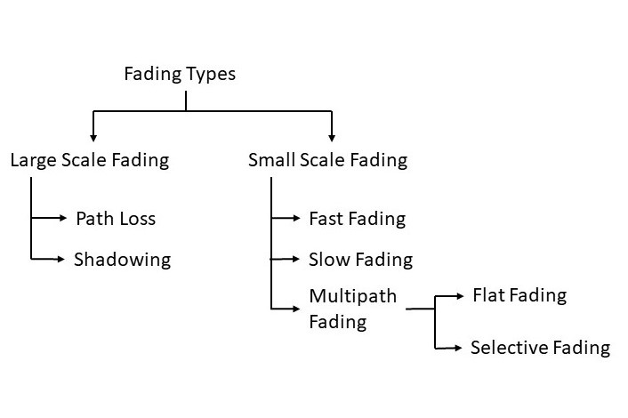
Fading Types

Slide 41
Multi-Path = Frequency-Selective!
f=0
0.5
0.5
1
1
0.5
1 μs
1 μs
f=1 MHz
1
0.5
0.5
1
0.5
-0.5
-1
1 μs
-1
1 μs
f=500 KHz
1
1
0.5
0.5
0.5
-0.5
-1
1 μs
-1
1 μs

Slide 42
Multi-Path = Frequency-Selective!
h(t)
|H(f)|
0.5
0.5
1
f (MHz)
1 μs
0
0.5
1
1.5
2
A multi-path channel treats signals with different frequencies differently
A signal composed of multiple frequencies would be distorted by passing through such channel

Slide 43
Frequency-Selective Channels
OFDM transmitter and receiver operate in a frequency-selective channel
delay dispersion
delay dispersion can lead to appreciable errors even when Sτ /Ts < 1
delay dispersion also leads to a loss of orthogonality between the subcarriers, and thus to Inter Carrier Interference (ICI)
Solution
negative effects can be eliminated by a special type of guard interval, called the cyclic prefix (CP)

Slide 44
Frequency Division & Coherence Bandwidth
Power
Frequency
Subdivide wideband bandwidth into multiple narrowband sub-carriers
Bandwidth of each channel is selected such that each sub-carrier approximately displays Flat Fading characteristics
The bandwidth over which the wireless channel is assumed to display flat fading characteristics is called the coherence bandwidth

Slide 45
Number of Subcarriers in OFDM
For band-limited FDM if the system bandwidth is B, number of sub-carriers is given by:
For OFDM if the system bandwidth is B, Number of sub-carriers is given by:
OFDM has the potential to at least double the number of sub-carriers (i.e., double the total transmission rate over the system bandwidth)

Slide 46
Intersymbol Interference in OFDM
T_{s}
T_{s}
Assume OFDM over two subcarriers: f₁=1/T_{s}, f₂=2/T_{s}
+
OFDM Symbol
Tx Signal

Slide 47
Intersymbol Interference in OFDM
OFDM Symbol
Tx Signal
Suppose multi-path channel with delay T_{s}/8
h₀
h₁
T_{s}/8
Inter-Symbol Interference (ISI)
OFDM Symbol
Rx Signal
Inter-symbol interference (ISI) occurs when one OFDM symbol affects the next one due to the multi-path channel

Slide 48
Inserting Guard Time
OFDM Symbol
Tx Signal
T_{s}/8
T_{s}
T_{s}
T_{s}/4
Guard Time
Suppose multi-path channel with delay T_{s}/8
h₀
h₁
T_{s}/8
Rx Signal
T_{s}/8
T_{s}
T_{s}
T_{s}/4
Guard Time
No ISI
Guard Time eliminates ISI between neighboring OFDM symbols
However each OFDM symbol suffers from inter-carrier interference (ICI)
Guard time corresponds to a reduction of bit rate

Slide 49
Guard Time & Inter-Carrier Interference
Tx Signal
Rx Signal
OFDM Symbol
OFDM Symbol
T_{s}/8
T_{s}
T_{s}/8
T_{s}
Guard Time
Guard Time
+
+

Slide 50
Guard Time & Inter-Carrier Interference
Rx Signal
Consider the receiver for f₁=1/T_{s} that correlates over T_{s} with
OFDM Symbol
T_{s}/8
T_{s}
T_{s}
Guard Time
Correlation at Rx over T_{s}
Not Orthogonal
x
+
Intra-Carrier Interference

Slide 51
Guard Time & Inter-Carrier Interference
Rx Signal
Consider the receiver for f₁=1/T_{s} that correlates over T_{s} with
OFDM Symbol
T_{s}/8
T_{s}
T_{s}
Guard Time
Correlation at Rx over T_{s}
Orthogonal
x
+
No Interference

Slide 52
Cyclic Prefix
Guard time between adjacent symbols is inserted to eliminate ISI
No ISI will occurs, if guard time is larger than delay spread
Guard time is a pure system overhead, contains no information
CP is inserted in order to preserve orthogonality
CP provides multipath immunity & synchronization tolerance
CP increases required transmission bandwidth, hence lowers spectral efficiency
Transmit power associated with CP is a waste

Slide 53
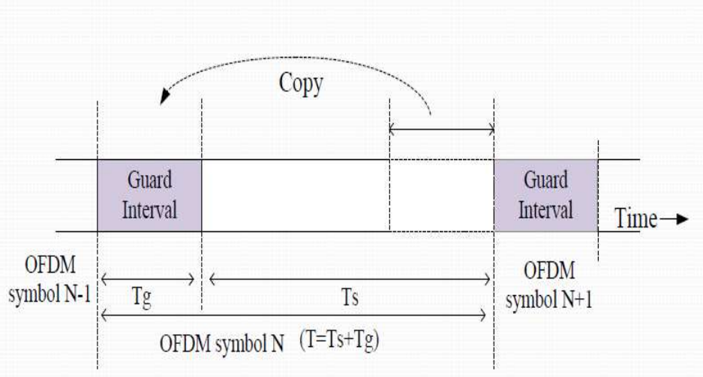
Insertion of cyclic prefix

Slide 54
Cyclic Prefix vs Guard Time
Guard Time | Cyclic Prefix
Eliminates Inter-symbol Interference | Eliminates Inter-symbol Interference
Suffers from Inter-carrier Interference | Eliminates Inter-carrier Interference
Suffers from Intra-carrier Interference | Suffers from Intra-carrier Interference
Causes a reduction in data rate as a result of the increased OFDM symbol time | Causes a reduction in data rate as a result of the increased OFDM symbol time
Does not consume additional power associated with OFDM symbol time expansion due to the guard time | Necessitates additional power associated with OFDM symbol expansion due to the introduction of cyclic prefix

Slide 55
Performance in Frequency-Selective Channels
The cyclic prefix converts a frequency-selective channel into a number of parallel flat-fading channels.
This eliminates ISI in TDMA and CDMA systems.
An uncoded OFDM system has no frequency diversity.
If a subcarrier is in a fading dip, then error probability on that subcarrier is very high, and dominates the Bit Error Rate (BER) of the total system for high SNRs
uncoded OFDM has the same average BER irrespective of the frequency selectivity of the channel

Slide 56
Coded Orthogonal Frequency Division Multiplexing
coding can be used to improve performance in fading channels
coded bits is transmitted in an independent channel states results in a high diversity order
designing appropriate mappers and interleavers that assign the different coded bits in the time-frequency plane is required.
This mapping, depends on the frequency selectivity as well as the time selectivity of the channel.
If the channel is highly frequency selective, then it might be sufficient to code only across available frequencies, without any coding or interleaving along the time axis.
This has two advantages:
works in static channels, which occur quite often for wireless LANs and
other high-rate data transmission scenarios;
on the other, the absence of interleaving in the time domain results in lower latency of the transmission and decoding process

Slide 57
SNR Analysis
First, compare 1-tap (i.e. flat) Rayleigh-fading channel vs AWGN.
i.e. y = hx + w vs y = x + w
Note: all multipaths with random attenuation/phases are aggregated into 1-tap
Next consider frequency selectivity, i.e. multi-tap, broadband channel, with multi-paths
Effect: ISI
Equalization techniques for ISI & complexities
Generalize! Consider diversity in time, space, frequency, and develop efficient schemes to achieve diversity gains and coding gains

Slide 58
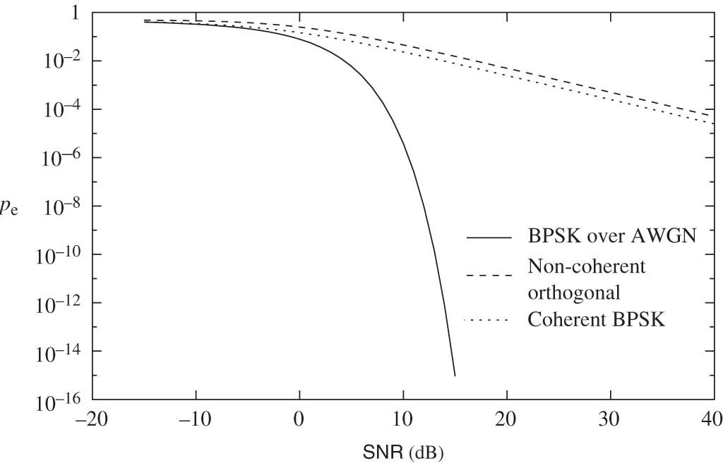
Single-tap, Flat Fading (Rayleigh) vs AWGN
Why do we have this huge degradation in performance/reliability?

Slide 59
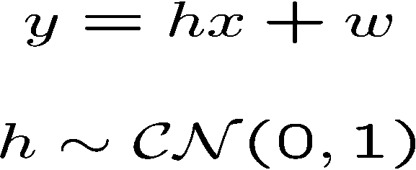

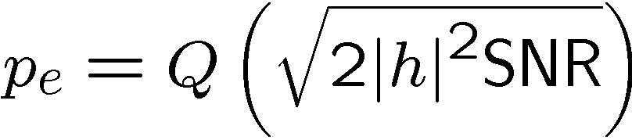
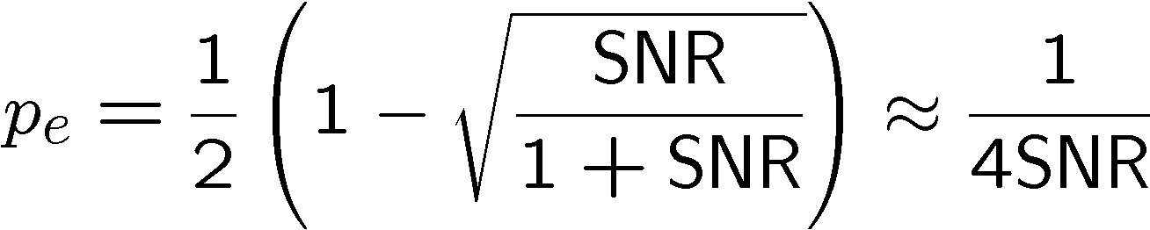
Rayleigh Flat Fading Channel
BPSK: Coherent detection.
Looks like
AWGN, but…
Conditional on h,
p_{e} needs to be
“unconditioned”
Averaged over h,
To get a much
poorer scaling
at high SNR.

Slide 60
BER vs. SNR (cont.)
Frequency-selective channel (equalization or Rake receiver)
BER
Frequency-selective channel (no equalization)
“BER floor”
AWGN channel (no fading)
Flat fading channel
SNR
means a straight line in log/log scale

Slide 61
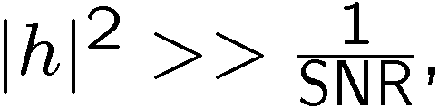
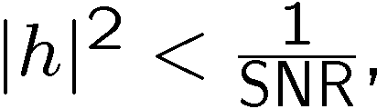
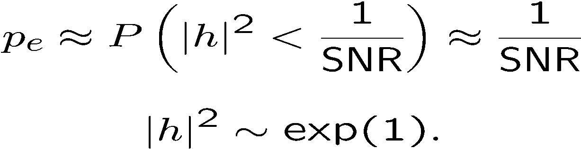
Typical Error Event
Conditional on h,
When the error probability is very small.
When the error probability is large:
Typical error event is due to: channel (h) being in deep fade!
… rather than (additive) noise being large.

Slide 62
Channel Estimation
In a wireless system, operation of OFDM systems requires an estimate of the channel transfer function, or, equivalently, the channel impulse response.
Since OFDM is operated with a number of parallel narrowband subcarriers, it is to estimate the channel in the frequency domain.
Ie, to obtain the N complex-valued channel gains on the subcarriers.
denote these channel attenuations as h_{n},_{i}, where n is the subchannel index and i is the time index.
Assuming that we know the statistical properties of these channel attenuations, and structure to the OFDM signal, we can derive good channel estimators.
three approaches to estimate the channel:
(i) pilot symbols- which are mainly suitable for an initial estimate of the channel;
(ii) scattered pilot tones-which help to track changes in channels over time; and
(iii) eigenvalue-decomposition-based methods,-which can be used to reduce the complexity of the first two methods

Slide 63
Effects of PAPR
The power amplifiers at the transmitter need to have a large linear range of operation.
nonlinear distortions and peak amplitude limiting introduced by the High Power amplifier (HPA) will produce inter-modulation between the different carriers and introduce additional interference into the system.
additional interference leads to an increase in the Bit Error Rate (BER) of the system.
one way to avoid non-linear distortion is by forcing the amplifier to work in its linear region. Unfortunately such solution is not power efficient and thus not suitable for wireless communication.
The Analog to Digital converters and Digital to Analog converters need to have a wide dynamic range and this increases complexity.
if clipped, it leads to in-band distortion (additional noise) and ACI (out-of-band radiation)

Slide 64
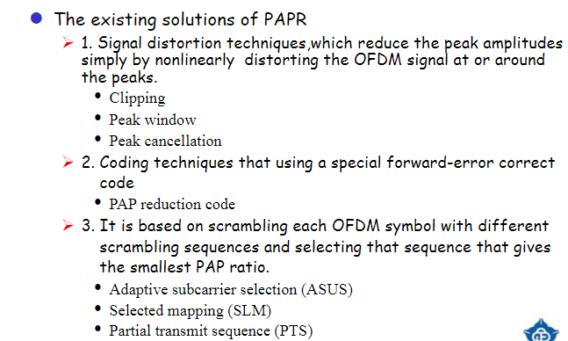

Slide 65
Improvement of PAPR
Several methods have been proposed to reduce the PAPR of OFDM signal
Data coding technique
The main disadvantage of this method is to degrade
transmission efficiency
Clipping technique
The main disadvantage of this method is to degrade
BER performance
Active Constellation Extension technique
The main disadvantage of this method is to degrade average power
Phase alignment technique
The main disadvantage of this method is required to transmit
side information which leads the degradation of transmission
efficiency

Slide 66
Mitigation of Fading: Freq. Equalization
Conduct channel estimation for h₀ and h₁
Divide the correlated signal by β=h₀+h₁cos(φ_{ii})
Requires channel estimation
For low value values of β equalization also results in noise amplification

Slide 67
Mitigation of Fading: Precoding
Conduct channel estimation for h₀ and h₁
Divide the transmitted signal by β=h₀+h₁cos(φ_{ii})
Requires channel estimation
Requires channel estimation knowledge at transmitter
Does not result in any noise amplification at the receiver
For low values of β, excessively high transmission power might be needed at the transmitter

Slide 68
Mitigation of Fading: Adaptive Loading
Distribute power over sub-carriers such as to maximize total system data rate
Requires channel estimation
Requires channel estimation knowledge at transmitter

Slide 69
Impairment in OFDM
•
• Symbol Timing Offset (TO)
• Due to the unknown transmission time or propagation delay of OFDM symbol at receiver
•
Carrier Frequency Offset (CFO)
• Frequency differences between the transmitter and receiver oscillator
• Oscillator instabilities
• Doppler shift of mobile channels
• Phase noise
• Sampling Clock Offset
These errors cause Inter symbol Interference(ISI) and Inter carrier Interference(ICI)
6

Slide 70
Introduction Timing Offset
Carrier Frequency Offset
Frequency Offset Estimation With Fast Acquisition
References
7

Slide 71


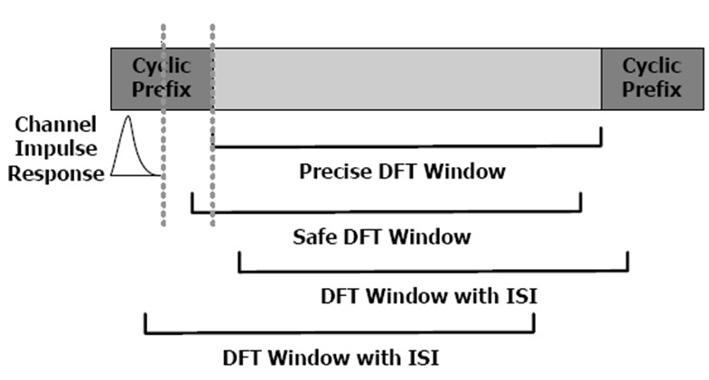
Timing Offset
➢
Window overlapping of the two successive OFDM symbols raises to ISI
•
Due to incorrect position of the FFT window at receiver for Start Symbol.
➢
Introduces Inter-symbol Interference(ISI) and phase shift to the desired symbol components.
➢
(TO) can be avoided by keeping the window start point within the ISI free region of cyclic prefix (CP) for each symbol.
Larger the CP, the more TO , a system can tolerate.
➢
8

Slide 72
Timing Offset Estimator
➢
GOAL : To determine the start symbol position at receiver to avoid the ISI and ICI.
▪
Pilot Based Method : (useful for systems with low SNR)
• Pilots (pseudo-random sequences or null symbols) can be used to determine the start of an OFDM symbol.
Pilot-symbols can be OFDM based or Non-OFDM based.
•
In case of continuous data , a null signal is appropriate , for bursty data this is not true.
▪
Non-Pilot based Method :
• Most method exploits the redundancy of cyclic-prefix(CF) to find the start symbol position.
Some algorithms use the periodicity of the correlation function of the time domain OFDM symbol.
•

Slide 73
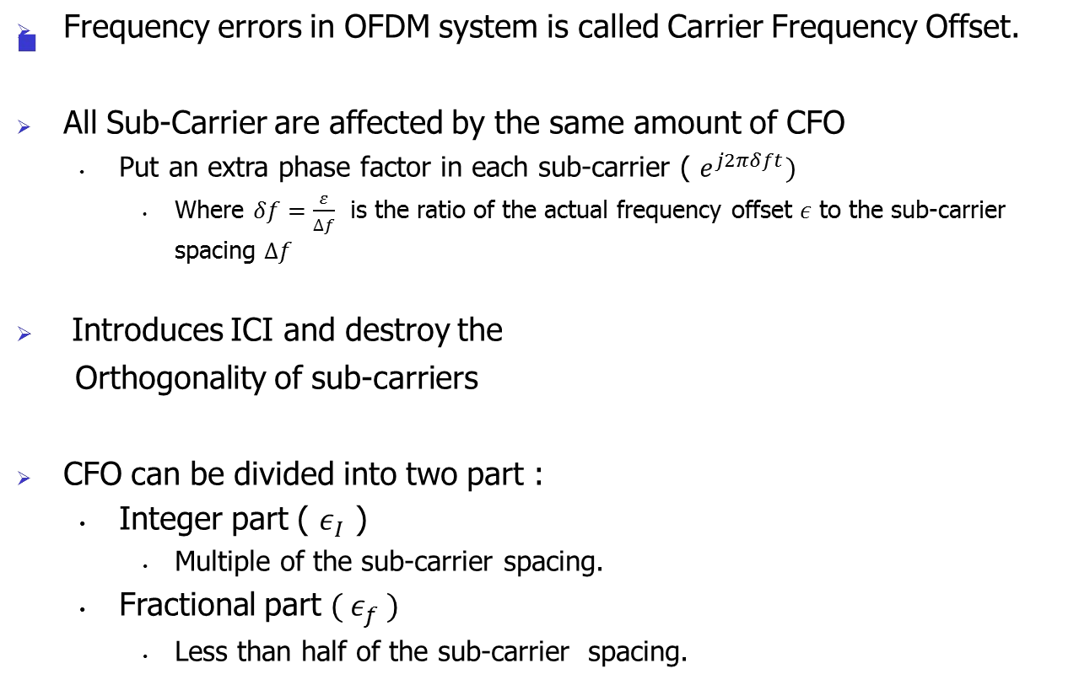
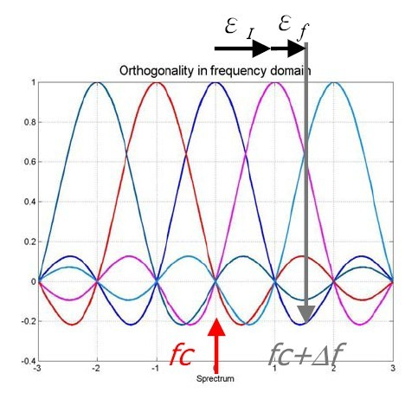
Carrier Frequency Offset

Slide 74
Effect of CFO in OFDM
When the receiver is perfectly synchronized with the transmitter, and the discrete channel is ISI-free, the IDFT and DFT operators in OFDM systems appear cascaded and give the identity operator.
In the presence of carrier asynchronism, orthogonality of the multiplexed signals is destroyed and interference is created between the data symbols in a DFT block.

Slide 75
UNIT -2 Problems
OFDM System Design - Problem & Solution
https://www.youtube.com/watch?v=_Hq85tXYd8U
Case Study : IEEE 802 11a - OFDM STANDARD
https://www.youtube.com/watch?v=7h2KE7GGqZE
Datarate Calculation for IEEE 802.11a standard
https://www.youtube.com/watch?v=wMD-V8wUQKE

Slide 76
References
https://silicondsp.com/OFDM_Tutorial_PDF_Files.html
http://www.conniq.com/WiMAX/fdm-ofdm-ofdma-sofdma-01.htm

Slide 77
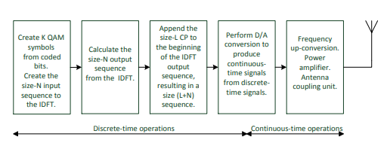

Slide 78
